Slide 1
Foreign Exchange
(Forex，FX)

Slide 2
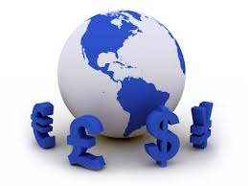
Learning Objectives
Learning Objectives
  A comprehensive introduction to Foreign Exchange markets, participants, quotation and conventions, trading instruments and basic calculations.
  A ‘wholesale’ of ideas facilitating the audience to dig into FX details.
  A preliminary coverage of FX derivatives is an optional part.
Scope
  FX Markets
  FX Quotation and Order
  FX trading instruments with Basic calculations

Slide 3
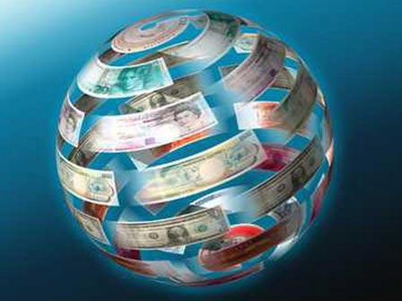
Session 1
Foreign Exchange Market

Slide 4
Overview of Financial Markets
Capital markets, which consist of Stock markets and Bond markets
Money markets
Commodity markets
Derivatives markets, including Forward, Future and Option markets.
Insurance markets
Foreign exchange markets

Slide 5
What is Foreign Exchange
Foreign Exchange (also known as “Forex" or "FX") is the exchange of one country's currency for another. All foreign exchanges are determined by a rate of exchange, or a ratio valuing one currency against another.
Ex: USD 1 = CNY 6.1918

Slide 6
What is Foreign Exchange (cont.)
In finance, the exchange rate between two currencies specifies how much one currency is worth in terms of the other.
For example an exchange rate of 120 Japanese Yen to the Dollar means that ¥120 is worth the same as $1.
An exchange rate is also known as a foreign exchange rate, or FX rate.
Each sovereign state issues and manages its own currency through a national central bank. The exception is the Euro Zone.
Notes:
sovereign state：主权国家

Slide 7
Foreign Exchange Market
The foreign exchange market is the place where currencies are traded. The overall forex market is the largest, most liquid market in the world with an average traded value that exceeds $5.3 trillion per day(2014) and includes all of the currencies in the world.
There is no central marketplace for currency exchange, rather, trade is conducted over-the-counter. The forex market is open 24 hours a day, five days a week, with currencies being traded worldwide among the major financial centers of London, New York, Tokyo, Zürich, Frankfurt, Hong Kong, Singapore, Paris and Sydney - spanning most time zones.
Notes:
$5.3 trillion： 5.3 万亿美元
Zürich： 苏黎世

Slide 8
Foreign Exchange Market (cont.)
The forex is the largest market in the world in terms of the total cash value traded, and any person, firm, or country may participate in this market.
Only about 15% of FX is directly driven by cross-border trade in goods and services. Approximately 85% is driven by capital transactions conducted by banks for financial engineering and speculation.
Notes:
financial engineering and speculation：金融工程和理论学说

Slide 9
Foreign Exchange Market (cont.)
Most liquid Market
Exchange rates are highly sensitive to a great variety of factors
Round-the-clock market
Main international Banks continuously provide both bid and ask rates
Exchange rate fluctuations are usually caused by actual monetary flows as well as anticipations on global macroeconomic conditions
Traded in pairs like, USD/JPY, EUR/USD, GBP/USD, USD/CAD etc.
Notes:
市场流动性是指在保持价格基本稳定的情况下，达成交易的速度或者说是市场参与者以市场价格成交的可能性。
Round-the-clock market:24小时市场
Fluctuations： 波动
Anticipation： 预期

Slide 10
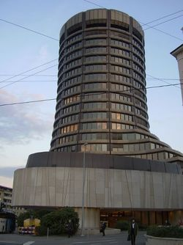

Foreign Exchange Market (cont.)
Average daily international foreign exchange trading volume was $5.3 trillion in March 2013 according to the BIS study :
$2.0 trillion spot（即期） Foreign Exchange
$3.3 trillion in derivatives, ie.
  $680 billion in outright forwards （远期）
  $2.2 trillion in forex swaps （互换）
  $337 billion in FX options. （期权）
Notes:
BIS：国际清算银行 Bank for international settlements

Slide 11
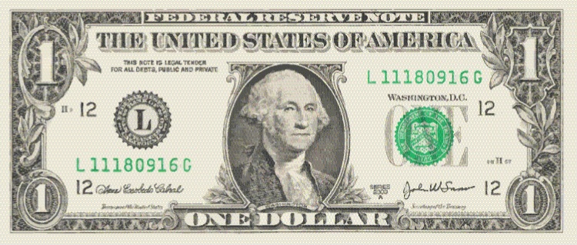
Foreign Exchange Market Top 5 Most Traded Currencies
RANK CURRENCY CODE SYMBOL
1 U.S. Dollar USD $
Notes:
1美元 第1、2届美国总统——乔治·华盛顿
2美元 第3届美国总统杰斐逊
5美元 第16届总统亚伯拉罕·林肯
20美元 第7届美国总统安德鲁·杰克逊,美国第一任民选总统。他是一个传奇，对美国政治的影响可谓深远。“人人都可成为总统”的梦想从他开始
50美元 第18届总统尤里西斯·格兰特·葛仑，美国的常胜将军，西点军校毕业，美国内战在他的手中结束，凭借其显赫的战功，成功当选为总统。
100美元 头像不是总统，而是著名科学家、金融家、政治家本杰明.富兰克林 ,因为他曾在美国独立战争时期起草著名的《独立宣言》

Slide 12
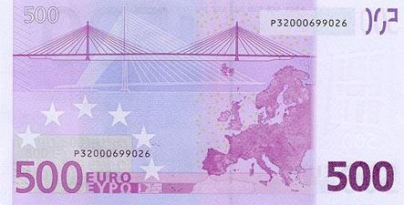
Foreign Exchange Market Top 5 Most Traded Currencies (cont.)
RANK CURRENCY CODE SYMBOL
2 Euro EUR €
Notes:
欧元纸币在欧元区12个成员国均为统一设计的图案，共分7种面值：500欧元、200欧元、100欧元、50欧元、20欧元、10欧元和5欧元，运用了赤、橙、黄、绿、青、蓝、紫七个不同的颜色。

Slide 13
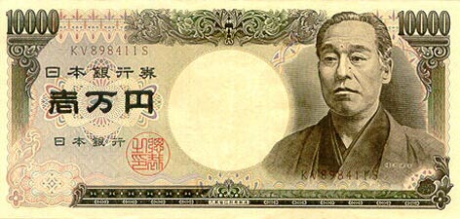
Foreign Exchange Market Top 5 Most Traded Currencies (cont.)
RANK CURRENCY CODE SYMBOL
3 Japanese Yen JPY ¥
Notes:
在目前流通的一万日元的钞票上，印着一位身穿和服的日本人肖像，他就是被誉为“日本近代文明缔造者”的著名启蒙思想家福泽谕吉(1835年—1901 年)。正是这位出身低贱而又性格叛逆的学者，在100多年前将原本崇尚中华文明的日本引上了“脱亚入欧”的道路，并推动日本一步步走向了侵略扩张。
五千元的头像，把原是《武士道》作者、农政学家、外交家的新渡户稻造换成了女作家樋口一叶（1872－1896）。
新版一千元的头像是生物学家野口英世1876～1928)Noguchi Hideyo

Slide 14
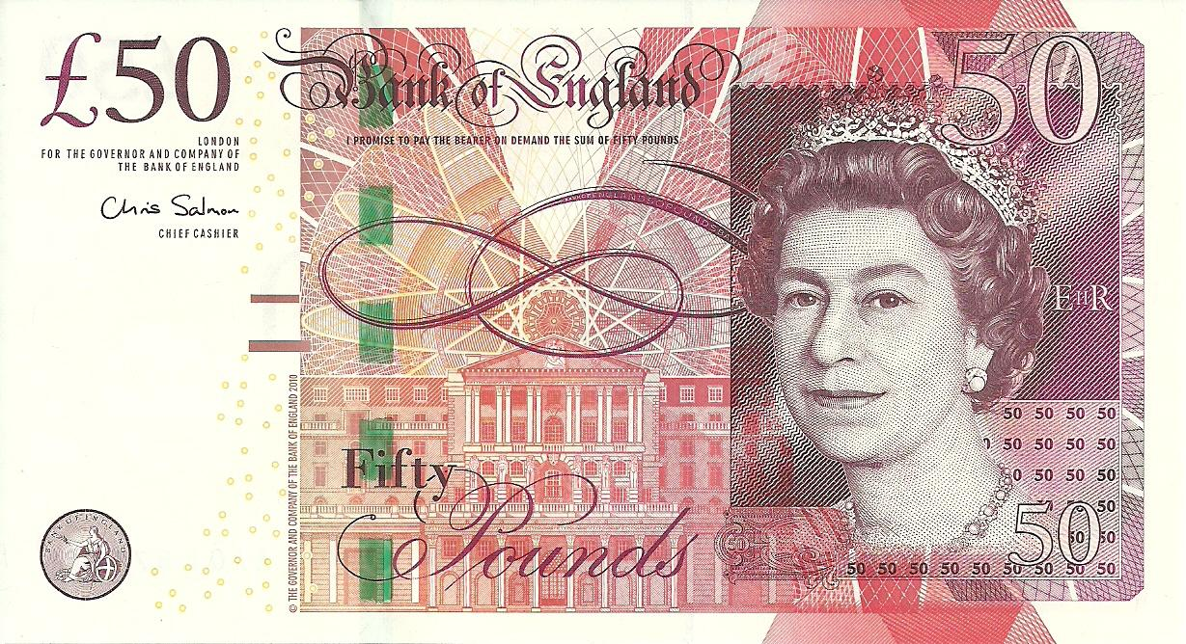
Foreign Exchange Market Top 5 Most Traded Currencies (cont.)
RANK CURRENCY CODE SYMBOL
4 British Pound GBP £
Notes:
所有英镑的正面都是英国女王伊丽莎白，反面的图案则根据钱币的面值各有不同。
伊丽莎白二世，现任英国君主，是英国、英联邦及15个成员国的国家元首，同时也是英国国教会的最高首领。她于1952年6月2日登基，是目前在世的在位时间第2长的国家元首（仅次于1946年即位的泰国泰王普密蓬•阿杜德），同时也是英国在位时间第3长的君主（仅次于维多利亚女王（1837年－1901年在位）以及乔治三世(1760年－1820年)）。以她为国家元首的国家中大约生活着1.25亿人。

Slide 15
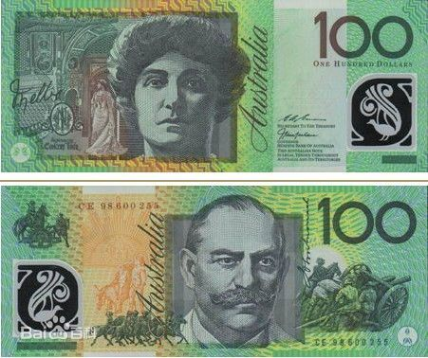
Foreign Exchange Market Top 5 Most Traded Currencies (cont.)
RANK CURRENCY CODE SYMBOL
5 Australian Dollar AUD $
Notes:
◎正面：澳大利亚女高音歌唱家梅尔巴，背景是悉尼女王剧院，左边是梅尔巴的签名。背景是梅尔巴于1902年在澳大利亚的巡回演出。
◎背面：澳大利亚杰出的军事将领莫纳什爵士。右侧是在一战中，攻打德军的兴登堡防线中的炮兵与骑兵。

Slide 16
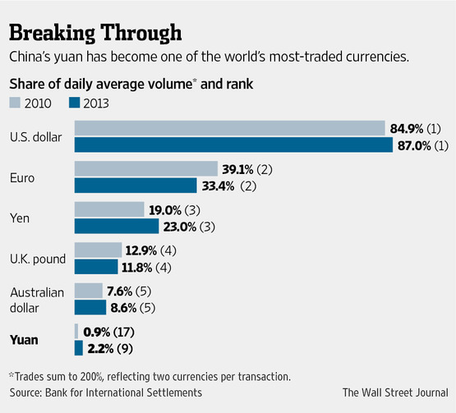
Foreign Exchange Market Top 5 Most Traded Currencies (cont.)
Trading in the Chinese currency(CNY), also known as the renminbi, has more than tripled over the past three years, to $120 billion a day in 2013.
The Chinese yuan vaulted to ninth in the Bank for International Settlements' latest report on foreign-exchange turnover, surpassing the Swedish krona and New Zealand dollar, among other widely used currencies.

Slide 17
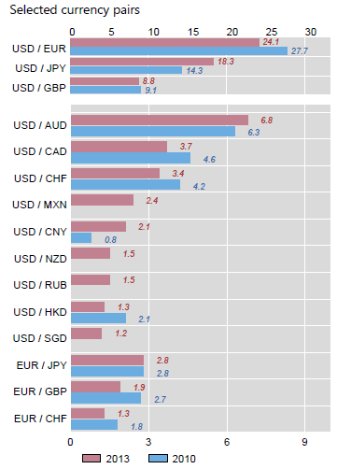
Foreign Exchange Market (cont.)
Referring to BIS study, in FX spot market heavily traded products are:
  - EUR/USD - 24.1%
  - USD/JPY - 18.3%
  - GBP/USD - 8.8%
US currency was involved 87% of transactions, followed by the euro (33%), the yen (23%) and sterling (12%)
The foreign exchange market is thus still overwhelmingly dollar-centered

Slide 18
Foreign Exchange Market World FX Markets Ranking
% of Market
United Kingdom 41%
United States 19%
Singapore 6%
Japan 6%
Hong Kong 4%
Switzerland 3%
Australia 3%
…… ……
China (Mainland) Less than 1%
* BIS (Bank of International Settlement), Triennial Survey, 2013

Slide 19
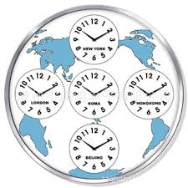
Foreign Exchange Market (cont.)
Round the clock Market – Market opens from Sydney – Tokyo - Hong Kong – Singapore – Dubai – London – Frankfurt – Paris - New York
FX market is open 24 hours a day throughout the week.
Closing worldwide Friday afternoon at 5pm New
York time, ie 2100 GMT, and reopening Sunday
1900 GMT when Wellington, New Zealand opens on
their Monday morning

Slide 20
Foreign Exchange Market Participants
Exporters and Importers - Trade Finance
- Cross Border Trade in goods and services
Remittances - by salaried class employed overseas/ ex-pats
Speculators - Banks, Hedge Funds, Investment Managers, Non-financial companies
DATA:
  Interbank Trading – 53%
  Between Bank and A Fund Manager – 32%
  Between Bank and a financial company – 15%

Slide 21
Quiz I
Why do individuals and companies need Foreign Exchange? 出国，跨国贸易，获取利益
Where do they trade?
foreign exchange market外汇市场柜台交
over-the-counter柜台交易
What challenges do they face when trading FX, comparing with Stock and Bond trading? Do they have any/some facilities?
24h round-the-clock Most liquid Trade in pair
T+0 T+1

Slide 22
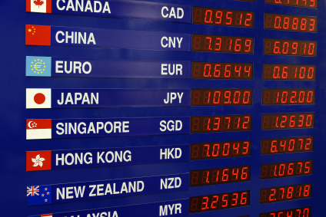
Session 2
Foreign Exchange Quotation and Order

Slide 23
Exchange Rate
The exchange rate between two currencies specifies how much one currency is worth in terms of the other.
An exchange rate is also known as a foreign-exchange rate, forex rate or FX rate.
For example an exchange rate of 102 Japanese yen (JPY, ¥) to the United States dollar (USD, $) means that JPY 102 is worth the same as USD 1

Slide 24
Exchange Rate Bid/Offer Spread
Like any other market, there is a Bid/Offer Spread – Difference between buying and selling prices.
Market maker buys at a lower price and sells at a higher price. For example: 1 USD = 1.3273/1.3275 CHF means, I as a market maker, buy 1 USD at 1.3273 CHF and sell 1 USD at 1.3275 CHF.
But, this is narrow spread only for interbank market or wholesale market. 仅限于银行和批发市场
For Individual currency speculators, spread is more, say, 1 USD = 1.3250/1.3300 CHF 利差很大
Notes:
CHF: 瑞士法郎

Slide 25
Exchange Rate Quotation
An exchange rate quotation is given by stating the number of units of a counter currency that can be bought in terms of 1 Base currency.
Counter Currency is also called as Given Currency or Variable Currency.
Two types of Quotations:
  Market Quotation
  Inverted Quotation

Slide 26
Exchange Rate Quotation (cont.)
Market Quotations are the quotations which market players use in Trading and is popularly quoted across all the Trading centers.
For ex: 1 USD = 1.2025 CAD
1 EUR = 1.1880 USD
1 GBP = 1.7550 USD
Inverted Quotations are the reverse of the Market Quotations. Inverted quotations are reciprocal to Market Quotations.
For ex : 1 CAD = 0.8316 USD
1 USD = 0.8417 EUR
1 USD = 0.5698 GBP

Slide 27
Exchange Rate Quotation (cont.)
Quote Pair : USD / HKD
Bid / Ask (offer) : 7.7753 / 7.7780
Spread point: 27 basis points
Quote convention: the last two digits of decimal point (e.g. 53, 80)
Direct quote: Foreign currency/Local currency
    Eg. In Hong Kong, the quote: USD/HKD=7.7753/7.7780
Indirect quote: Local currency/Foreign currency
    Eg. In Sydney, the quote: AUD/USD=0.7358/0.7361

Slide 28
Exchange Rate Quotation (cont.)
In foreign exchange markets, the base currency is the first currency in a currency pair.
Exchange rates are quoted in per unit of the base currency
Currently the euro is the dominant base currency against all other global currencies.
Many market participants use the expressions "currency 1" and "currency 2", where one unit of CCY1 equals a variable number of units of CCY2.

Slide 29
Exchange Rate Types of Orders
Market orders-buy/sell at the market
Limit Orders
Condition
Price above the limit Price below the limit
Buy Take-Profit Stop-Loss
Action
Sell Stop-Loss Take-Profit

Slide 30
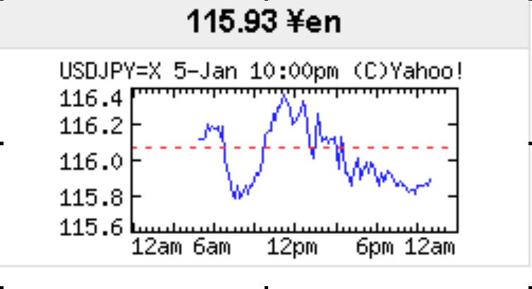
Exchange Rate How traders make money
SSB Sells USD 10 Mio ag. JPY at 116.20 at 6:00 AM on 5th Jan 2006
SSB Buys USD 10 Mio ag. JPY at 115.80 at 9:00 AM on 5th Jan 2006
PROFIT OR LOSS ?
10,000,000* ( 116.20 – 115.80 ) = JPY 4,000,000 PROFIT
Or 4,000,000/115.80 = USD 34,542.31 PROFIT

Slide 31
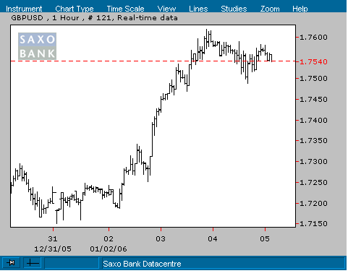
Exchange Rate How traders make money
JPM Chase sold GBP 10 Mio against USD at 1.7250 on 2nd Jan 2006.
Expecting GBP to weaken further to 1.7000 levels.
View goes wrong.
GBP moved to 1.7600 on 4th January 2006.
If JPM Chase unwinds the position on 4th Jan 2006, the loss on the trade is 10,000000 * ( 1.7600 – 1.7250) = USD 350,000
Notes:
外汇市场上的交易金额100万美元被称作1球，作为交易的一个基本单位。缩写MIO。MIO is a written abbreviation for "millions" as a unit indicator in the financial markets

Slide 32
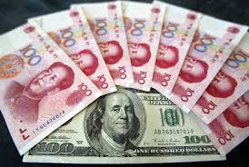
Exchange Rate Regime
Fixed Exchange Rate : is a type of exchange rate regime wherein a currency's value is matched to the value of another single currency or to a basket of other currencies, or to another measure of value, such as gold.
  For Ex: Chinese RMB use to be stable for many years around 1 USD = 8.27 (盯住美元)
Floating exchange rate or a flexible exchange rate is a type of exchange rate regime wherein a currency's value is allowed to fluctuate according to the foreign exchange market.
  For Ex: EUR/USD, GBP/USD, AUD/USD, USD/CHF etc.

Slide 33
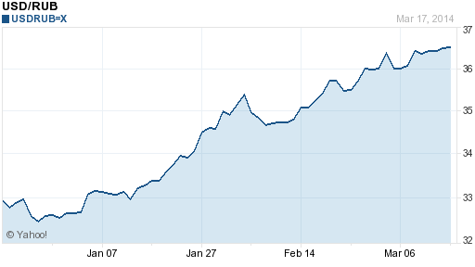
Exchange Rate
Demand and Supply
Country’s level of business activity and FOREX RESERVES.
Gross Domestic Product (GDP) and Employment Levels
Volume of Trade / Exports & Imports
Trade Deficit/Current Account Deficit
Interest Rates / Monetary Policy
Political stability

Slide 34

Quiz II
Suppose you are an FX Trader on EUR/GBP, and the market rates are quoted at 0.8293/97.
  A client calls to buy EUR 1m, what rate will you sell him at? 0.8293
  Suppose you have an intimate relationship with that client, what POSSIBLE rate will you sell him at?0.8297
  The client wants to put a stop-loss limit order, what price will you suggest him? And the take-profit order?
Suppose the US Central Bank (Fed.) announces an interest rate increase, what is the normal reaction in FX markets?大家都加息

Slide 35
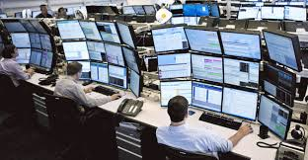
Session 3
FX Trading Instruments

Slide 36
X-Rate Trading Instruments Spot Exchange
The exchange of two currencies for immediate delivery, normally with T+2.
Some spot exchanges can be delivered on the same day (T+0) or “Value TOM-tomorrow” (T+1), depending on the country market practices. Eg. USD/CAD
Example:
  Trade Date: May 13th, 2005
  Value Date / Settlement Date : May 15th, 2005

Slide 37
X-Rate Trading Instruments FX Spot
Reuters Screen for FX Spot prices:
Currency Pair |  | BID | OFFER | Bank | High Bid | Low Bid
EUR/USD |  | 1.1880 | 1.1882 | JP Morgan | 1.1922 | 1.1860
GBP/USD |  | 1.7460 | 1.7462 | Deutsche Bk | 1.7475 | 1.7380
USD/JPY |  | 116.85 | 116.88 | HSBC Bank | 117.11 | 116.57
AUD/USD |  | 0.7275 | 0.7278 | RB of Aus | 0.7318 | 0.7265
USD/CAD |  | 1.1715 | 1.1718 | HSBC Bank | 1.1734 | 1.1692
USD/CHF |  | 1.3140 | 1.3145 | Std. Chd Bk | 1.3155 | 1.3102
USD/INR |  | 45.21 | 45.22 | State Bank | 45.34 | 45.18
USD/SGD |  | 1.1661 | 1.1664 | Deutsche Bk | 1.1686 | 1.1654

Slide 38
X-Rate Trading Instruments FX Spot Terminologies
Trade Date: The date on which the deal is concluded between the two counterparties.
Value Date: The date of settlement of currencies between each other. Spot Date is the value date for all FX Spot deals i.e, usually two working days.
Bid: Is the rate at which market maker buys the Base Currency
Offer / Ask : Is the rate at which market maker sells the Base Currency
Base Currency 1 EUR = 1.1880 USD Variable Currency

Slide 39
X-Rate Trading Instruments How is an FX Spot deal concluded
Bank A’s trader contacts Bank B’s trader on Dealing System for a EUR/USD Quote on 12/27/2005:
  Bank A’s trader: hihi.. EUR 10 pls (no disclosure of buy/sell intention)
  Bank B’s trader: Hi..Sure… 80/82
  Bank A’s trader: I BUY (disclosure of intention)
  I bought EUR 10,000,000 at 1.1882
  and sell USD 11,882,000 value spot 12/29/2005
  My EUR to Deutsche Bank, Frankfurt.
  Bank B’s trader: OK all agreed. I Sold EUR 10,000,000 at 1.1882
  and bought USD 11,882,000 value spot 12/29/2005
  My USD to JPM Chase New York.
  Thanks for the deal Bye.
  Bank A’s trader: All agreed. Bye.

Slide 40
X-Rate Trading Instruments FX – Spot: Buy Low/Sell High Policy
Sell-side clients always quote on Buy Low – Sell High Basis.
In the previous example, JPM Chase quotes 1 EUR = 1.1880/82 USD. That means,
- If JPM is hit on Bid side, it buys EUR 10 Mio at 1.1880 and sells USD 11,880,000.
- If JPM is hit on Offer side, it sells EUR 10 Mio at 1.1882 and buys USD 11,882,000.
Here, JPM buys at a lower price and sells at a higher price.
This priority is not available to buy-side client in the Market, because he is using the market for his requirements.

Slide 41
X-Rate Trading Instruments FX – Spot: Buy Low/Sell High Policy
SELL-SIDE CLIENT
BUY
LOW
SELL
HIGH
Pay lesser
Units of
Variable
Currency
For a fixed
Unit of Base
Currency
Receive more
Units of
Variable
Currency

Slide 42
X-Rate Trading Instruments FX – Spot: Cross Currency Rates
What is a Cross Currency Rate?
Fixing the rate of exchange between Foreign currency and Domestic Currency through the medium of some other currency ( usually USD) is done by what is known as “Chain Rule”. The rate thus, obtained is known as ‘CROSS CURRENCY RATE’ between these two currencies.
  EUR/USD = 1.1880/1.1882 and USD/CAD = 1.1715 / 1.1718
How to arrive EUR/CAD?
  EUR/CAD - Bid= 1.1880 * 1.1715 = 1.3917
  Offer= 1.1882 * 1.1718 = 1.3923
  So, EUR/CAD Cross Currency Rate is 1.3917 / 1.3923

Slide 43
X-Rate Trading Instruments FX Forward
Currency forward contracts, also known as "outright forward”, is the contract that holders are obligated to buy or sell the currency at a specified price, at a specified quantity, and on a specified future date.
Forward is quoted in premium/discount
  Eg. USD/HKD Spot = 7.7753 / 7.7780, 1 month forward points = 24/28 (in premium)
  USD/HKD 1m forward = 7.7777/7.7808

Slide 44
X-Rate Trading Instruments FX Forward: What is Premium/ Discount
Premium / Discount are always quoted in pips in FX Market.
In FX quotations, fourth decimal is a pip ( 0.0001 is one pip) except in USD/JPY where second decimal is a pip (0.01)
When Base Currency is said to be in PREMIUM, against Variable Currency, that means, Rate of Interest is LOWER for Base currency compared to that of variable currency for the period. In Example 1, EUR interest for 1 month is 2.50% and USD interest for 1 month is 4.50%. So, EUR is in PREMIUM.
When Base Currency is said to be in DISCOUNT, against Variable Currency, that means, Rate of Interest is HIGHER for Base currency compared to that of variable currency for the period. In Example 2, USD interest for 6 months is 5.00% and CHF interest for 6 months is 1.50%. So, USD is in DISCOUNT against CHF.

Slide 45
X-Rate Trading Instruments FX Forward: What is Premium/ Discount
How to calculate PREMIUM or DISCOUNT?
FX spot rates, fx Forward rates and interest rates are interrelated by the interest rate parity (IRP) principle. This principle is based on the notion that there should be no arbitrage opportunity between the FX spot market, FX forward market, and the term structure of interest rates in the two countries.
Premium or Discount are nothing but, loading of interest rates on respective currencies in a pair from the spot date till forward date to arrive at Forward rates.

Slide 46
X-Rate Trading Instruments Money & Forex Market Linkages (Optional)
Interest-Rate
Differential
The Interest Rate
Parity Theorem
The international
Fisher Effect
Forward Premium
Or Discount
Expected Rate of
Change of the
Exchange Rate
The Unbiased
Forward Rate Theory

Slide 47
X-Rate Trading Instruments Non-Deliverable Forwards (NDF)
An NDF is a short-term committed forward ‘cash settlement’ currency derivative instrument. It is essentially an outright (forward) FX contract whereby on the contracted settlement date, profit or loss is adjusted between the two counterparties basing on the difference between the contracted NDF rate and the prevailing spot FX rates on an agreed notional amount.
No actual movement of the principal amounts
Every NDF has a fixing date and a settlement (delivery) date. The fixing date is the day and time whereby the comparison between the NDF rate and the prevailing spot rate is made. The settlement date is the day whereby the difference is paid or received
Notes:
NDF（无本金交割远期）

Slide 48
X-Rate Trading Instruments FX SWAP
An FX swap is a combined spot and forward transaction with the same counterparty, concluded at the same time.
An FX Swap is a financial transaction whereby two parties exchange agreed upon amounts of two currencies as a spot transaction , simultaneously agreeing to reverse the transaction at a future date at two different rates.
This is simultaneous purchase and sale of one currency against another for two different maturities.

Slide 49
X-Rate Trading Instruments How is an FX Swap deal concluded
Bank A’s trader: Hi friend, EUR/USD Swap in EUR 10 Mio for spot over 1 month pls.
Bank B’s trader: Hi I deal you 20 / 22.
Bank A’s trader: At 20, I BUY and SELL (Dual deal) EUR 10 Mio value Spot 6th
Jan 2006 against 1 month ie., value 6th Feb 2006.
My EUR to Deutsche Bank, Frankfurt
My USD to SSB , New York.
Rates Please.
Bank B’s trader: OK all agreed, I SELL and BUY (Dual deal) EUR 10Mio value 6th Jan
2006 against 1 month ie., value 6th Feb 2006.
Rates are 1.1880 and 1.1900
My EUR to Dresdner Bank, Frankfurt.
My USD to Citibank, New York
Thanks for the deal and Bye.

Slide 50
X-Rate Trading Instruments Why the swap is needed?
The Bank or a corporate may not be in need of FX in the spot value date. Instead need it for a forward date.
Hence, they push the FX transaction from spot to forward through a Swap Deal.
But, FX Market does not quote actively in OUTRIGHT FORWARD. Market is active only in OUTRIGHT SPOT. Outright Forward is derived from the Outright Spot.
FX Swaps are done by the Banks typically to cover the forward transactions quoted to the corporate clients.

Slide 51
X-Rate Trading Instruments Corporate Transactions – FX Retail
Corporate and other client entities always look for FX rates for their business requirements-
A China Exporter who exports clothes to US.
The goods are invoiced in USD
Receives payments to his Account in USD
Has to convert USD into RMB
So, he has to sell USD and buy RMB.
WAL-MART imports radios from a China manufacturer.
The goods are invoiced in RMB.
WAL-MART has to make payment to the China Exporter in RMB
WAL-MART has to sell USD and buy RMB to make payments
(Until now not real!)

Slide 52
X-Rate Trading Instruments Factors to decide spread
The spread for a customer is decided by the Bank basing on certain factors
  Standing of the customer
  How important the client is for the Bank
  What is the total volume of business to the Bank
  What are the other spin-off benefits from the customer?

Slide 53
X-Rate Trading Instruments Factors to decide spread
Usually, Banks keep higher spread for smaller transactions.
Lesser spread for a good marketable lot.
For instance, for a 10 Mio EUR Transaction , Bank may keep a spread of 5 pips.
If the transaction is for EUR 80,000( this is called a Tiny Amount by the Trader), the sales trader keeps a spread of 20 pips.
This is because, smaller lots are not marketable immediately and hence, this is exposed to adverse movement in the currency pair. So larger spread gives leverage to the sales trader to accumulate the position till he gets a marketable lot and covers the position.
Notes:
Pip = "price interest point".

Slide 54
X-Rate Trading Instruments POSITION KEEPING and Hedging transactions
All customer transactions quoted and trade concluded end up the trader in Exposure of POSITION.
Till the Trader hedges the transaction with a counter trade in the interbank market OR matches with a equal ad opposite position, he remains exposed to the possible ADVERSE MARKET MOVEMENTS.
MARKET MAKER ( SELL-SIDE CLIENT) ALWAYS RUNS A HUGE POSITION AND COVERS HIS POSITION ON A CONTINUOUS BASIS AS AND WHEN HE DECIDES ITS THE RIGHT TIME TO HEDGE.

Slide 55
Quiz III
Suppose you are a bank trader, finding the outright spot rates in FX market are USD/CNY=7.1023/30, USD/CHF=1.4267/69:
  What rates can you get for CHF/CNY? 1/1.4267*7.1023=
  If you are an individual or a treasury officer of a trade firm, what rates may you get?
  高的那个
  If CHF is in premium against CNY, what are the possible rates? And what if CHF is in discount?
  > <
  How will you unwind your positions in CHF and CNY if you sell CHF to your client?
  如果要把CHF卖给客户,那么1个CHF换4.9786个CNY.
  如果你卖CNY给客户,你给他4.9774个CNY他给你一个CHF,也就是1CNY卖他0.2009CHF

Slide 56





Workflow - Inter Bank Trading
Bank A
Bank B
Step 2: Trader update FX position
On-Line System
Step 3: Trader create deal ticket & pass to Settlement Clerk
Step 1: Price Quote
A: What’s the price of 5 mil USD/HKD ?
B: 5 mil USD/HKD at 30, 50
A: Buy 5 mil HKD at 7730
B: Deal, 5 mil HKD at 7730
Dedicated Phone Line
Step 4: Settlement clerk of Bank A & B confirm with each other on the deal by phone or electronically (e.g. MT300)

Slide 57


Workflow - Settlement
InBound MT300
FX Confirmation
Matching with FX OMS
Make fund transfer
Fedwire if banks are in US and members of Federal Reserve
CHIPS other US bank
SWIFT MT 200, 202 for non USD nostro
Bank book reconciliation
Update Cash Position / Nostro Bank Book

Slide 58
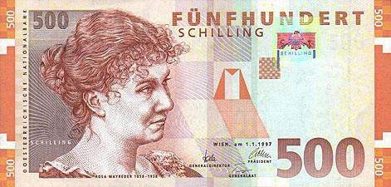
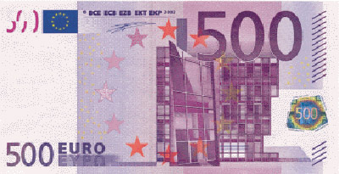
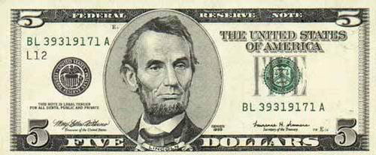
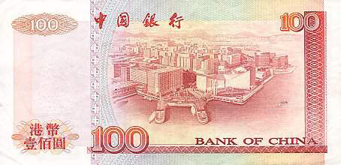
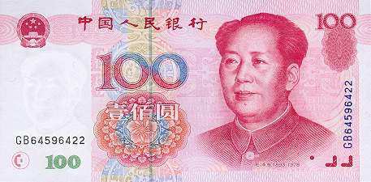

Slide 59

Derivatives

Slide 60


DERIVATIVES What is DERIVATIVES?
Financial contract which derives its value from the performance of another entity such as an asset, called the "underlying".
The most common underlying assets include Securities, Commodity, index, interest rate, or Currency
Derivatives are one of the three main categories of financial instruments, the other two being equities (i.e. stocks) and debt (i.e. bonds and mortgages).
Features： 1) Zero-Sum Game 2) High leverage
Notes:
（一）零和博弈：博弈各方的收益和损失相加总和永远为“零”。双方不存在合作的可能。也可以说：自己的幸福是建立在他人的痛苦之上的，二者的大小完全相等，因而双方都想尽一切办法以实现“损人利己”。零和博弈的结果是一方吃掉另一方，一方的所得正是另一方的所失，整个社会的利益并不会因此而增加一分。
(二)高杠杆性.衍生产品的交易采用保证金(margin)制度.即交易所需的最低资金只需满足基础资产价值的某个百分比

Slide 61
DERIVATIVES Participants of Derivatives
Hedgers
- is an investment position intended to offset potential losses/gains that may be incurred by a companion investment
Corporate/Banks, Financial Institutions to manage ALM and to hedge their proprietary positions/ Trade Business – Exporters and Importers
Speculators
- to capture market movements with an intention to make profits
Arbitragers
- is the practice of taking advantage of a price difference between two or more markets
Notes:
Hedgers:套期保值者
Speculators: 多头投机者和空头投机者
Arbitragers：套利者

Slide 62
DERIVATIVES Why DERIVATIVES are used?
Price determination
To hedge the risks
Reduce the costs and Enhance the yields
Manage Asset-Liability
Segregation of Liquidity & Interest Risk
Insurance
Notes:
Liquidity ：指资产变现能力，流动性愈大愈容易变现，股票的流动性就大于房地产。
利率风险是指市场利率变动的不确定性给商业银行造成损失的可能性。利率风险是银行的主要金融风险之一，由于影响利率变动的因素很多，利率变动更加难以预测，银行日常管理的重点之一就是怎样控制利率风险。

Slide 63
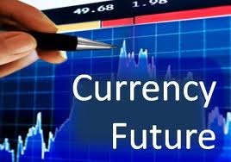
DERIVATIVES Currency Future
Future contract is a STANDARDIZED agreement with an organized exchange to buy or sell a currency pair at a fixed price at a certain date in the future.
The contract is exchangeable and thus more liquid.

Slide 64
DERIVATIVES Comparison of Forward & Future Contracts
 | Forward | Future
Size | Tailored | Standardized (typically USD5K – USD100K)
Range of Currencies | Over 50 | Limited to major currencies
Settlement Date | Tailored | Standardized, typical 4-6 times a year e.g. PHLX (Mar/May/Jun/Jul/Sep/Dec)
Cost | No fee, cost reflected in the spread points | No spread, paid as brokerage fee
Regulation | Self-regulated | Regulated by exchange
Credit Risk | Counterparty risk is significant | Minimized with marginal deposit and daily cash settlement of profits or loss
Mark to market | Only at maturity | Profit/Loss

Slide 65
DERIVATIVES Comparison of Forward & Future Contracts
 | Forward（远期） | Future（期货）
Size | Tailored（定制的） | Standardized (标准化的，typically USD5K – USD100K)
Range of Currencies | Over 50（超多币种） | Limited to major currencies（仅限于主流币种）
Settlement Date | Tailored | Standardized, typical 4-6 times a year e.g. PHLX (Mar/May/Jun/Jul/Sep/Dec)
Cost | No fee, cost reflected in the spread points | No spread, paid as brokerage fee
Regulation | Self-regulated（自我监管，自律的） | Regulated by exchange （交易所监管）
Credit Risk | Counterparty risk is significant（交易对手风险很大） | Minimized with marginal deposit and daily cash settlement of profits or loss
Mark to market | Only at maturity | Profit/Loss

Slide 66
DERIVATIVES Currency Options
Definition: A contract for future delivery of a specific currency in exchange for another, in which the holder of the option has the right to buy (or sell) the currency at an agreed price, the strike price, or exercise price, but is not required to do so.
The right to buy is call, the right to sell is a put
The option seller receives the option premium and is obliged to ensure the delivery
American options permit the holder to exercise at anytime before the expiration date whereas European options, only at the expiration date.
Two type of options market: Over the Counter (OTC) & Exchange Traded

Slide 67
DERIVATIVES Interest Rate Swaps (I.R.S)
Is a financial contract between two parties exchanging or swapping a stream of interest payments for notional principal amount on multiple occasions during a specified period.
LIBOR-0.5%
A Company
B Company
10%
10.25%
LIBOR+0.75%
FIXED
Floating

Slide 68
DERIVATIVES Interest Rate Swaps (I.R.S)
LIBOR-0.25%
LIBOR-0.50%
A Company
Bank
B Company
10%
10.25%
10%
LIBOR+0.75%
Fixed
Floating

